Slide 1
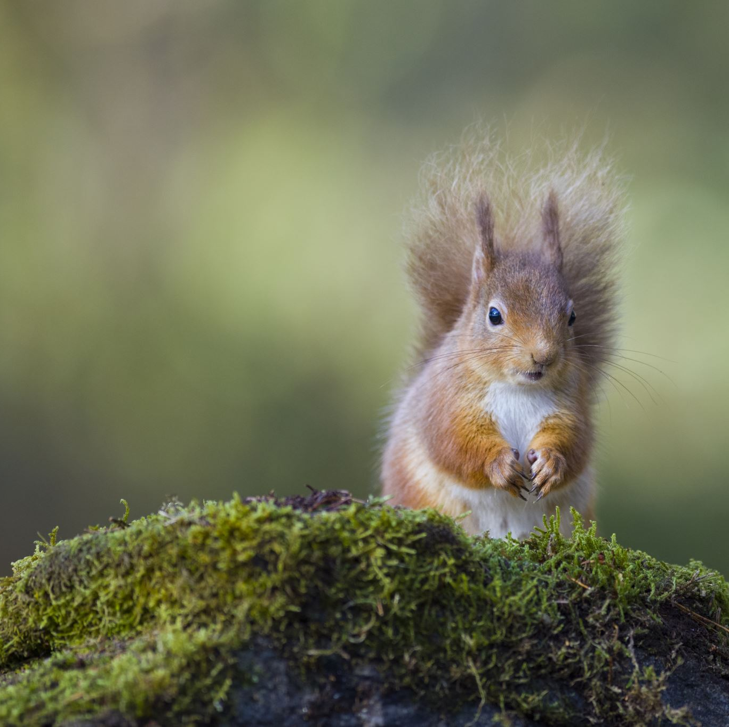
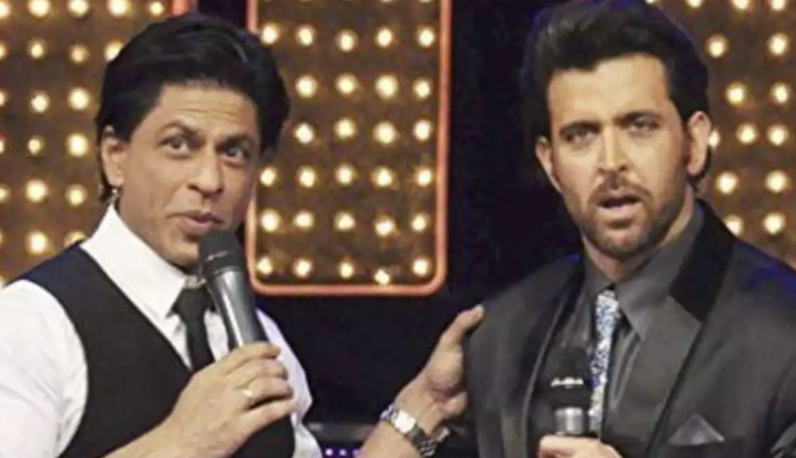
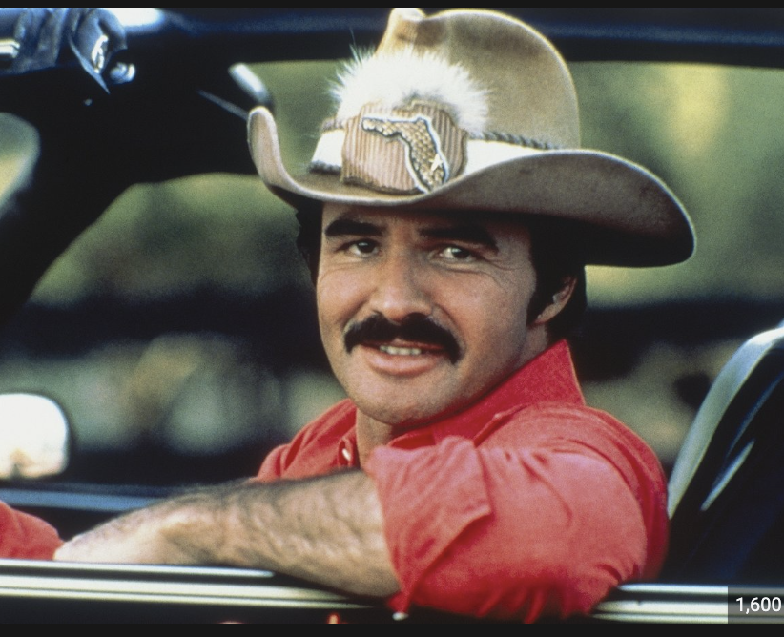
Nacho Average Bird Feeder: Keeping Squirrels Away with High Tech Surveillance
Bollywood Boys
and the
Hollywood Cowboy
+

Slide 2
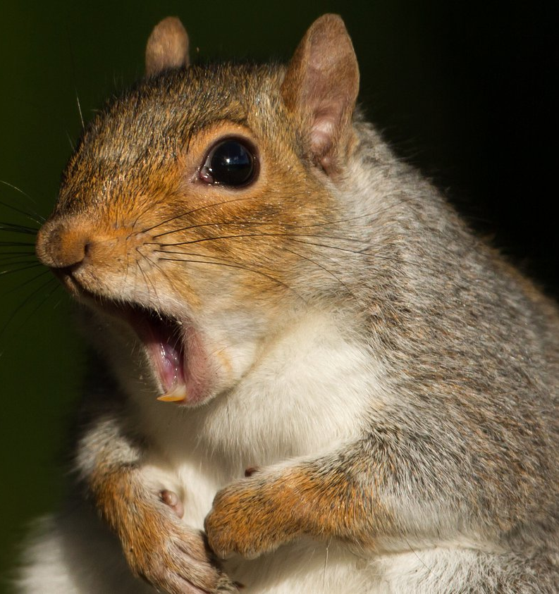
Problem
Many people use bird feeders to attract various avian species to their yards
However, squirrels often get into these feeders and steal the food meant for the birds
This means that the birds don’t have food

Slide 3
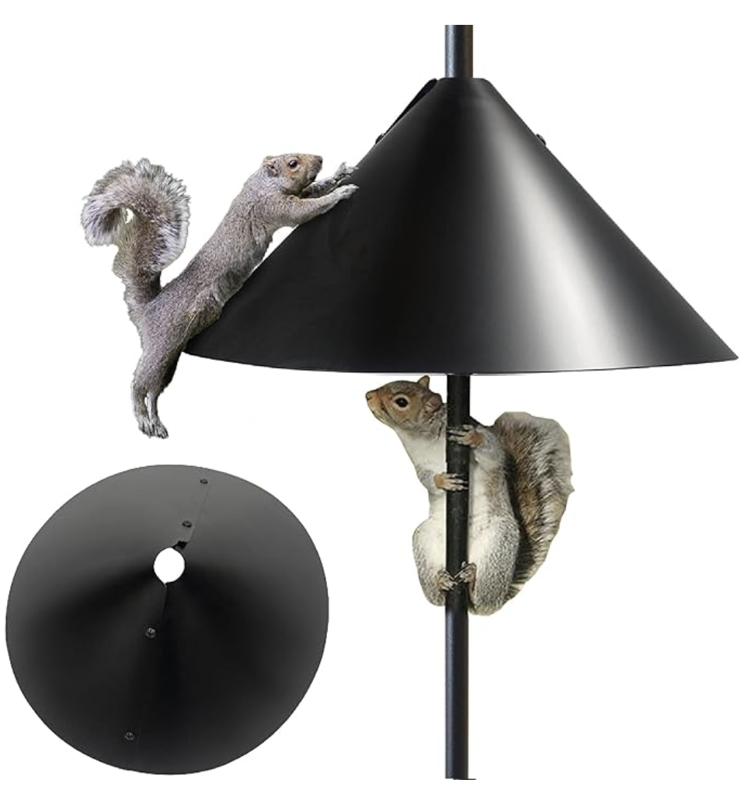
Previous Efforts
Covering the dispenser with cayenne pepper (need to do this every day)
Using safflower seeds to attract songbirds as squirrels don’t like safflower seeds (allegedly, mixed evidence)
Using a baffle (pictured left) to prevent the squirrels from climbing onto the feeder (they can jump from above)

Slide 4
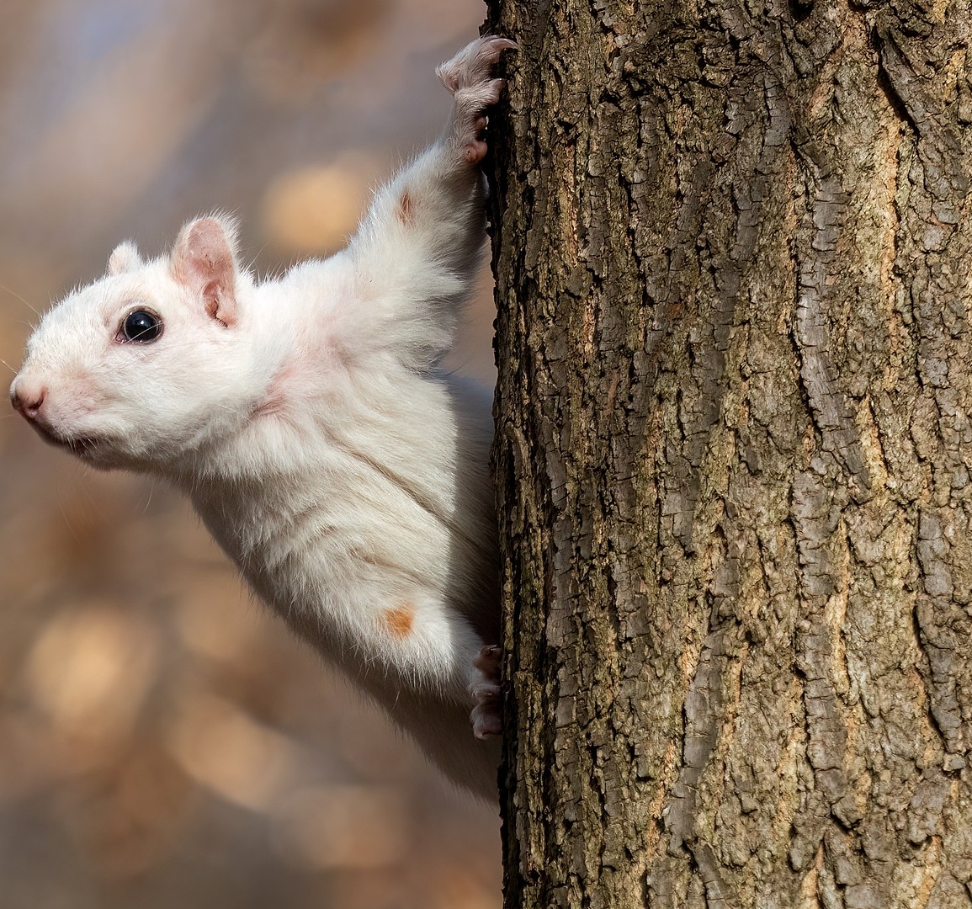
Our Solution
Use computer vision to detect squirrels and sound the alarm
Data Sources:
Various Kaggle Datasets that included pictures of birds and squirrels
Filtered out other animals
Selectively populated dataset to ensure that there wasn’t a class imbalance (many more pictures of birds than squirrels)
~ 3500 Squirrel Images and ~ 4500 Bird Images
Handles daytime and nighttime infrared images (novelty)

Slide 5
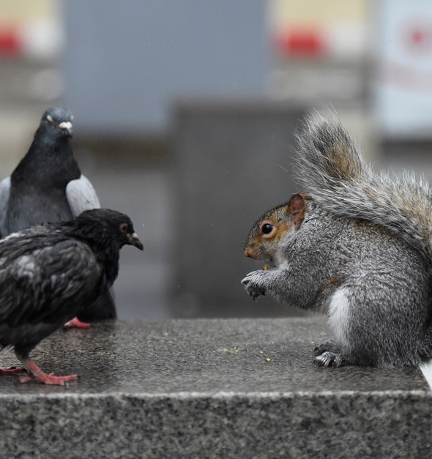

Model Evaluation Process - Metric Selection
Accuracy – data is not severely class imbalanced
Recall = $\frac{TP}{TP+FN}$
We don’t want to misclassify squirrels as birds (don’t want to scare birds away)
Notes:
Birds = Positive
Squirrels = Negative
Want to maximize recall because by doing so you would minimize the number of false negatives (birds classified as squirrels)
Alternatively, relative to squirrels, we want to maximize precision (decrease the number of false positives)

Slide 6
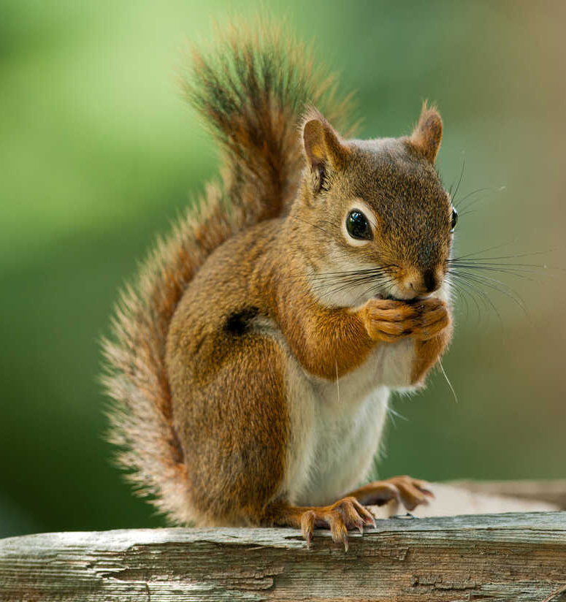
Modeling Approach - Data Pipeline
Data Aggregation & Cleaning
Train Test Split
Training (80%)
Test (20%)
AlexNet
SVM
Accuracy
+
Recall
ResNet

Slide 7
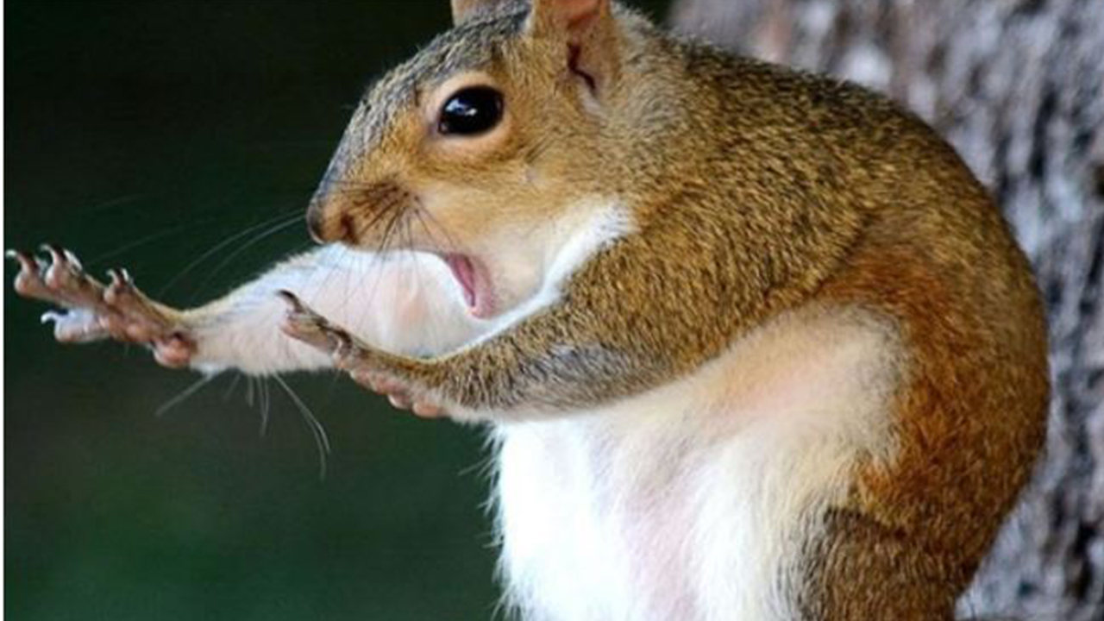
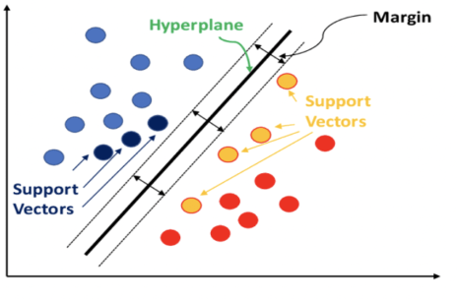
Modeling Approach – Models Evaluated
Non-Neural Net Approach: SVM
Boundary Points = Support Vectors
Decision Boundary
Maximize Distance Between Support Vectors
Accuracy: 61%
Recall: 100%

Slide 8
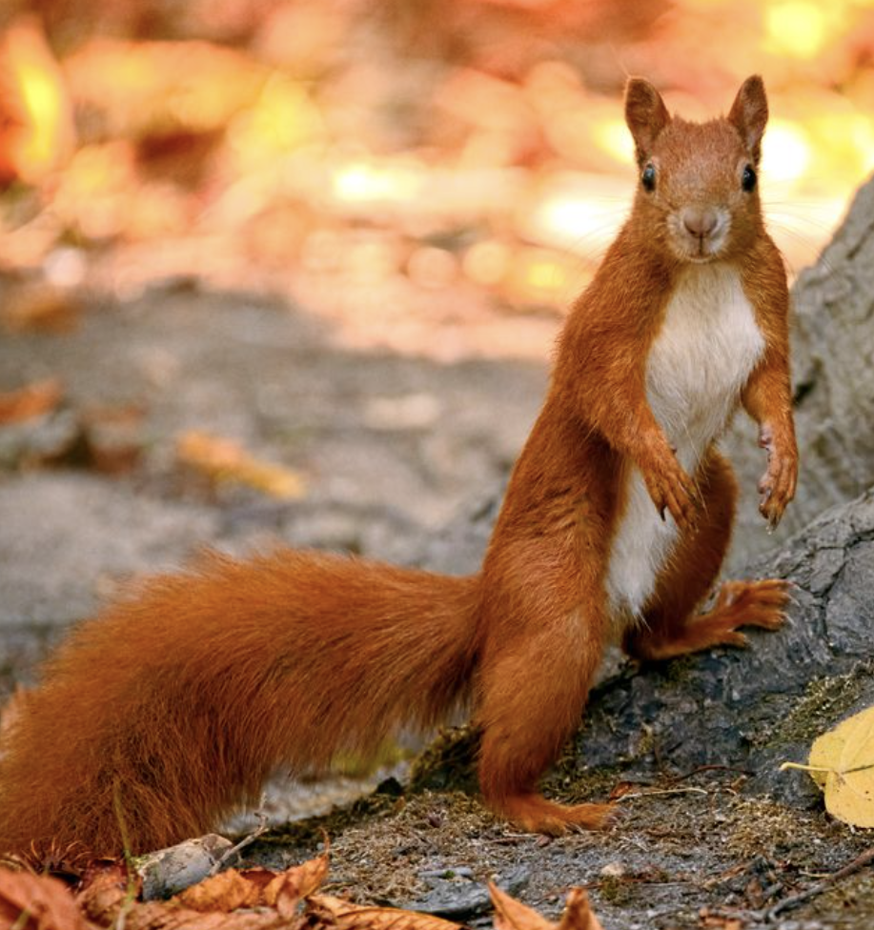
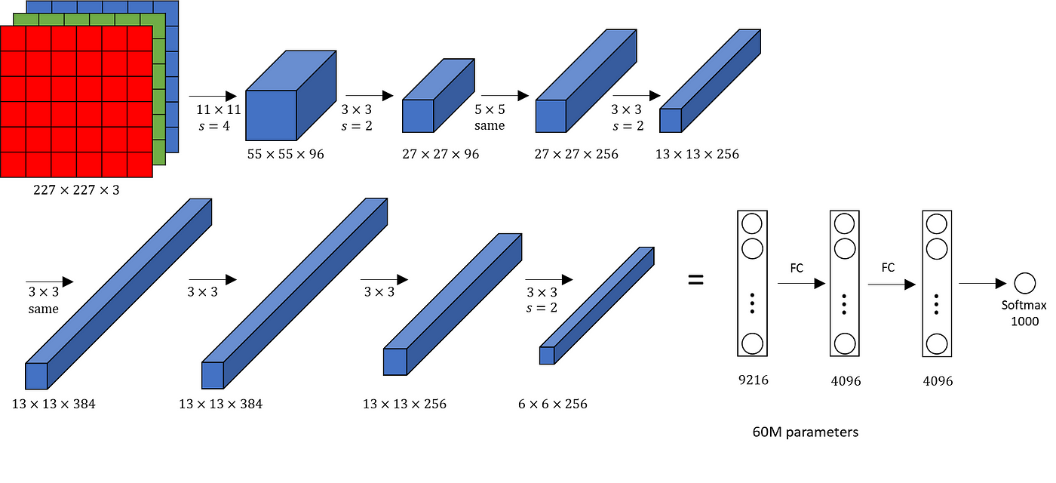
Modeling Approach – Models Evaluated
Mean Model: AlexNet
Pretrained model on ImageNet Dataset
Accuracy: 18%
Recall: 98%

Slide 9
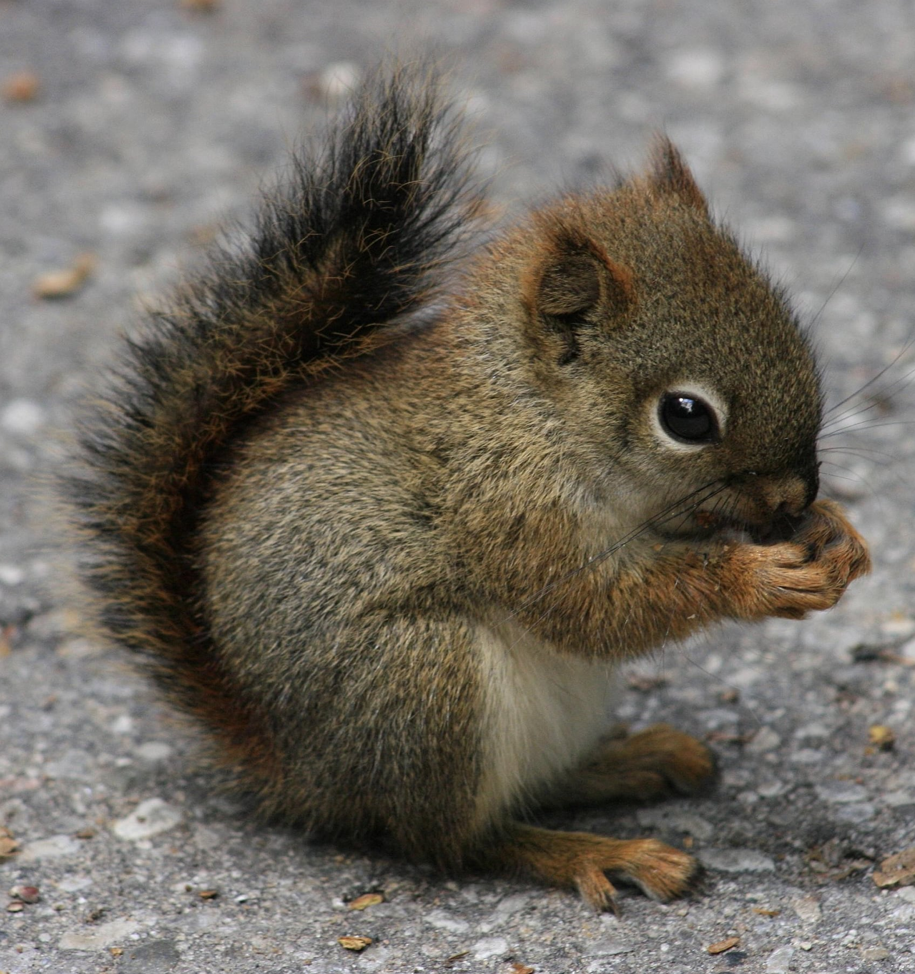
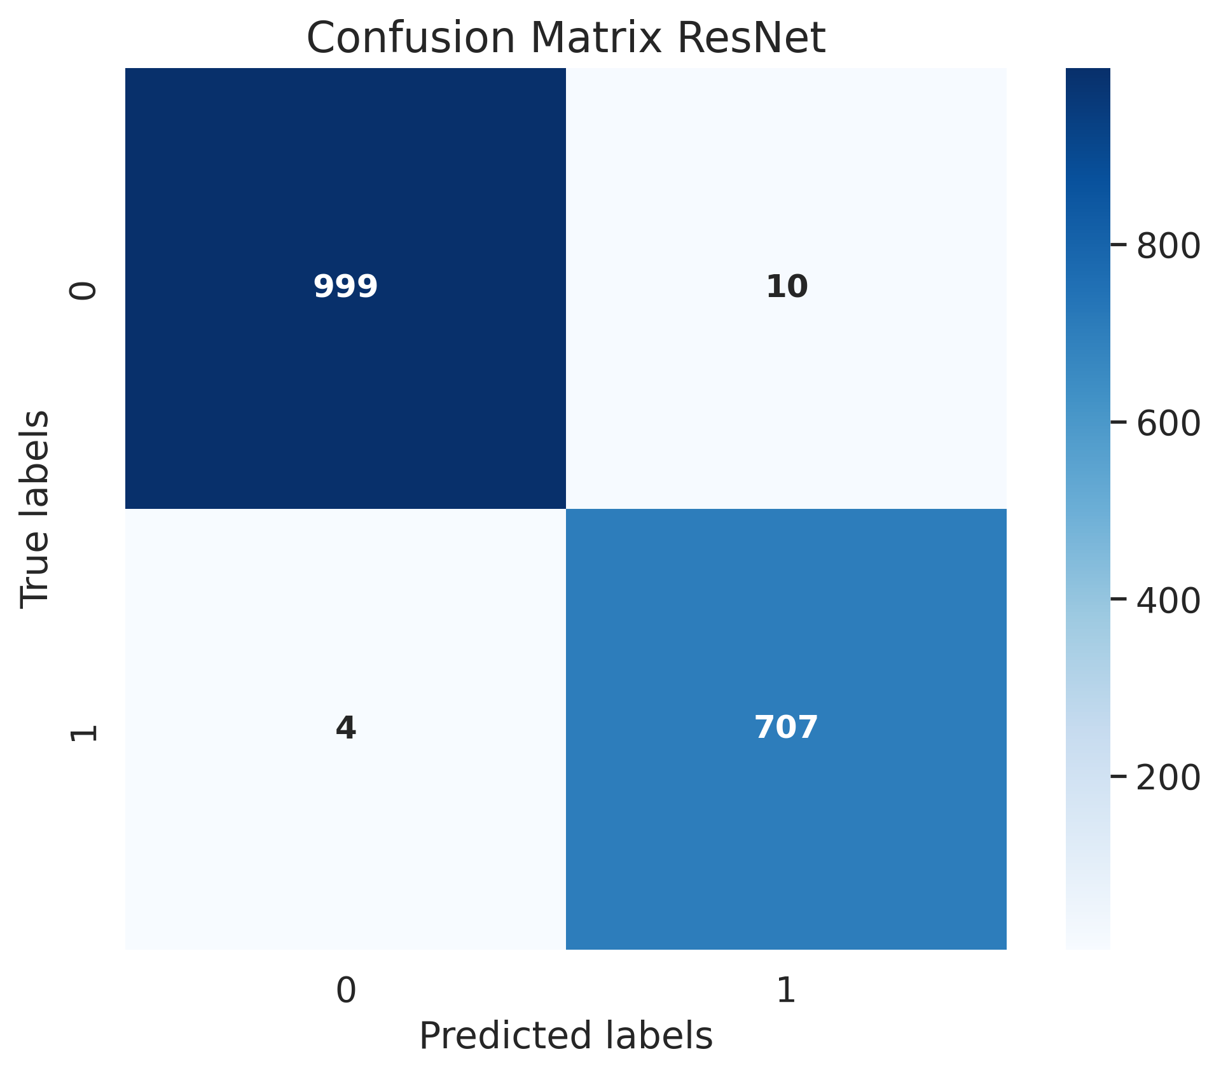
Modeling Approach – Models Evaluated
Neural Net Approach: ResNet Pretrained Model + Transfer Learning
Accuracy: 99.19%
Recall: 99%

Slide 10

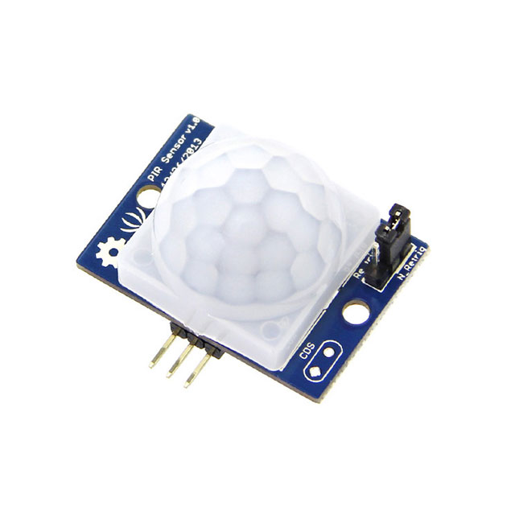
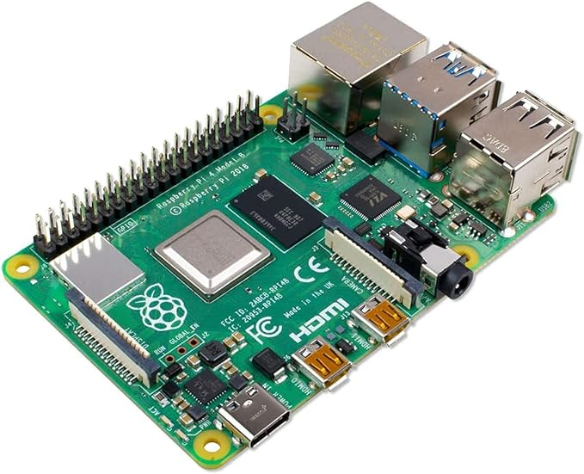

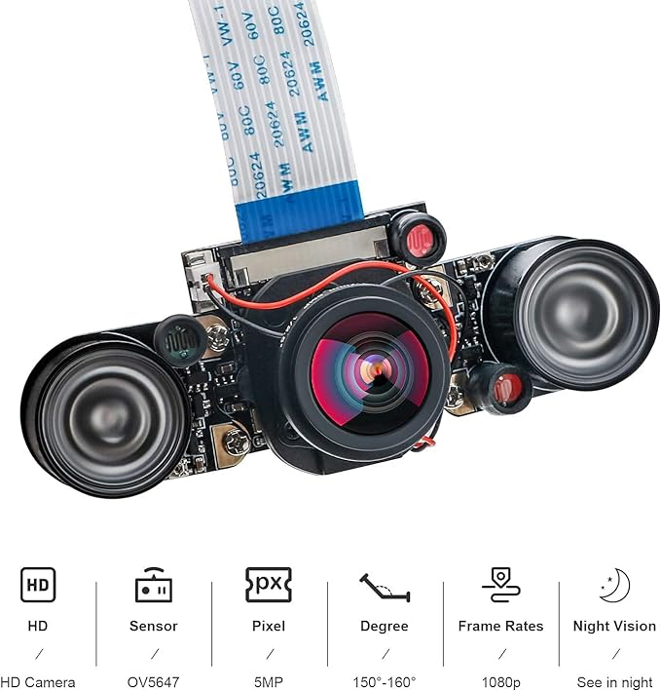
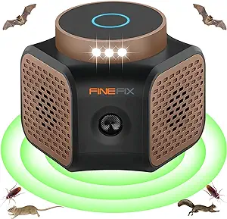
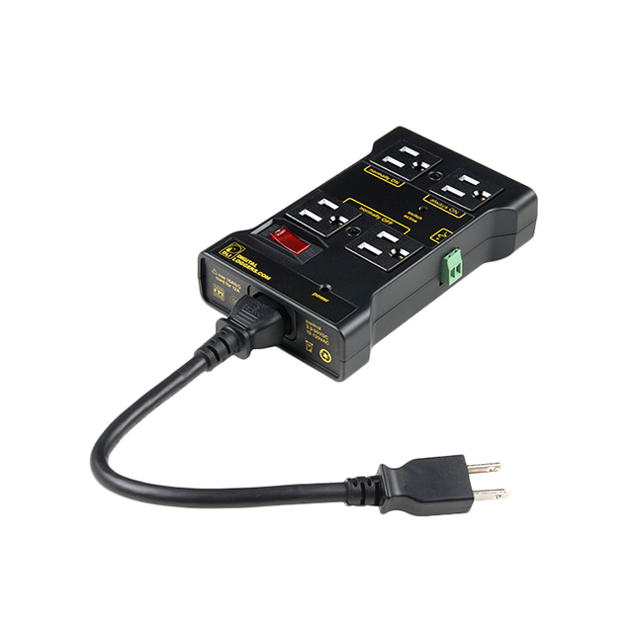
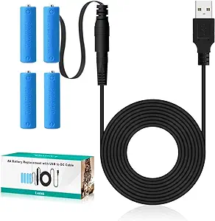
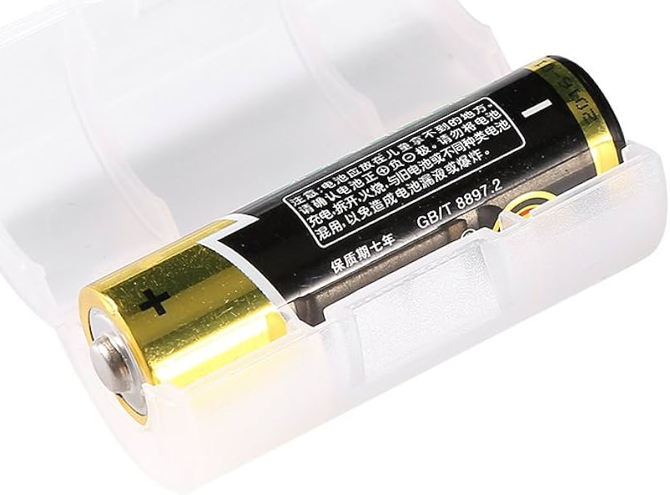
Demo
Motion Sensor
Raspberry Pi 4
1
4
IR Camera
3
5
2
Cloud Hosted Model
Ultrasonic Sound Box
6
AA Battery Converter
Power Supply
Converted AA to C Battery
9
8
7

Slide 11
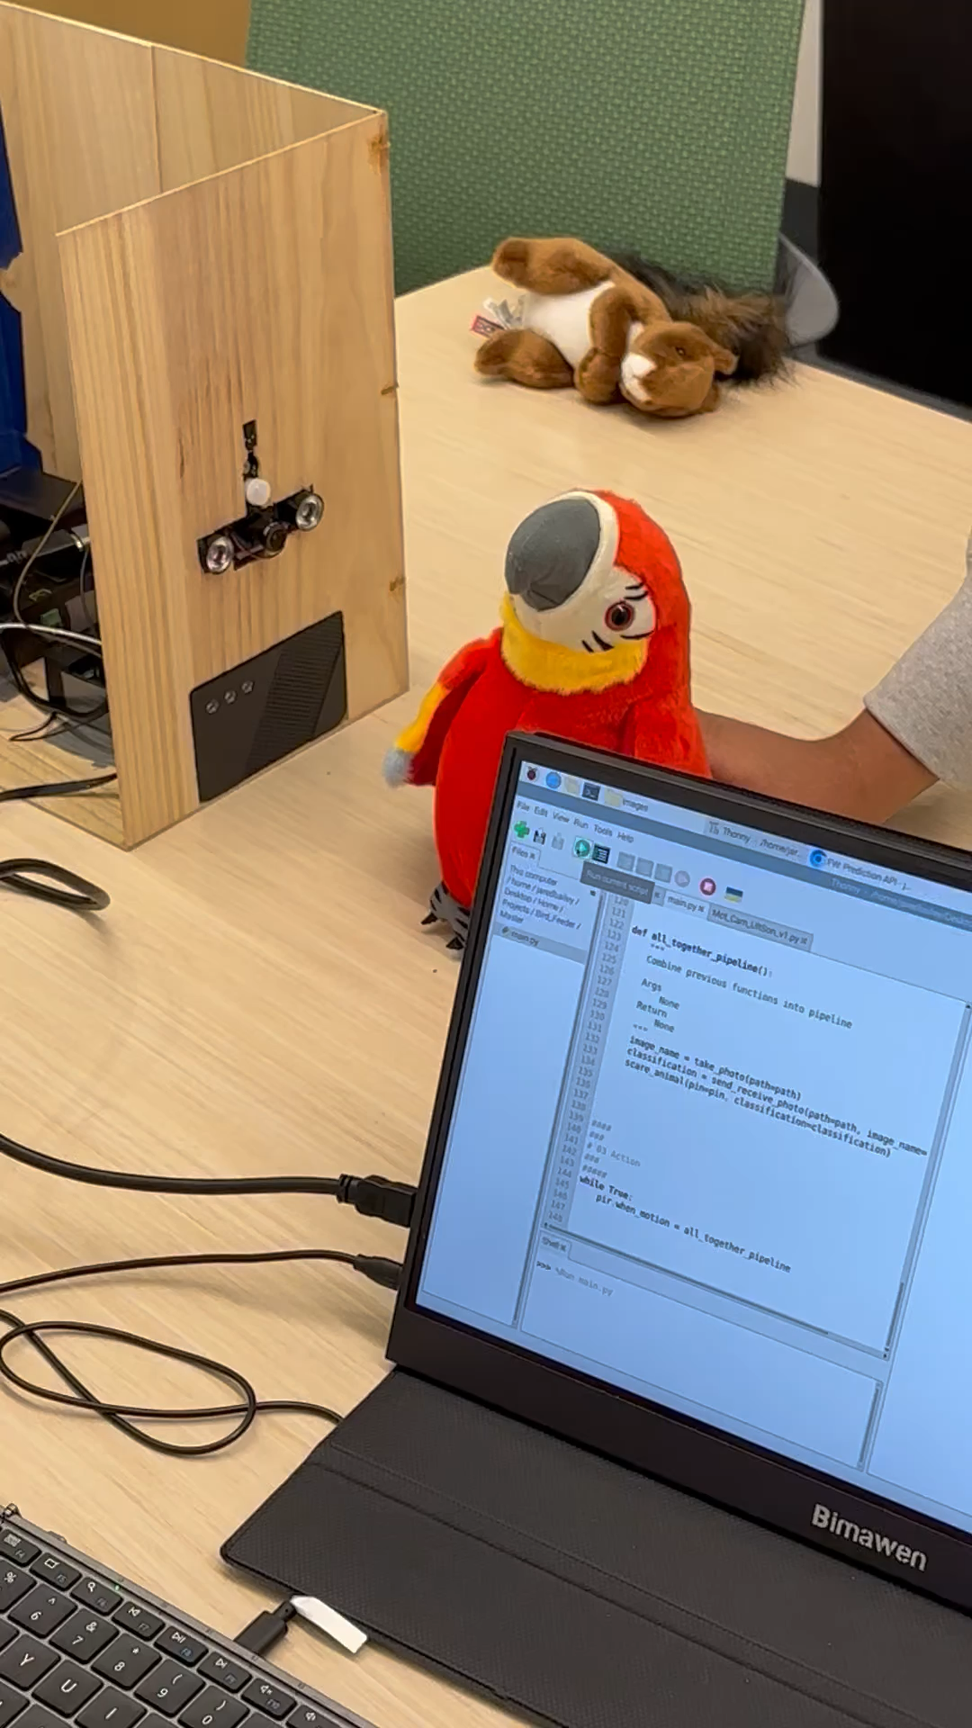

Demo

Slide 12
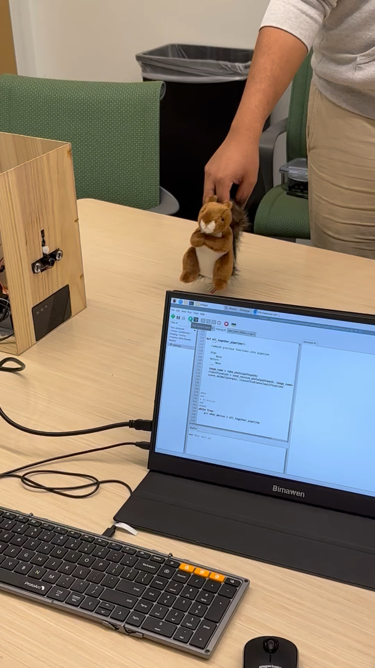
Demo

Slide 13
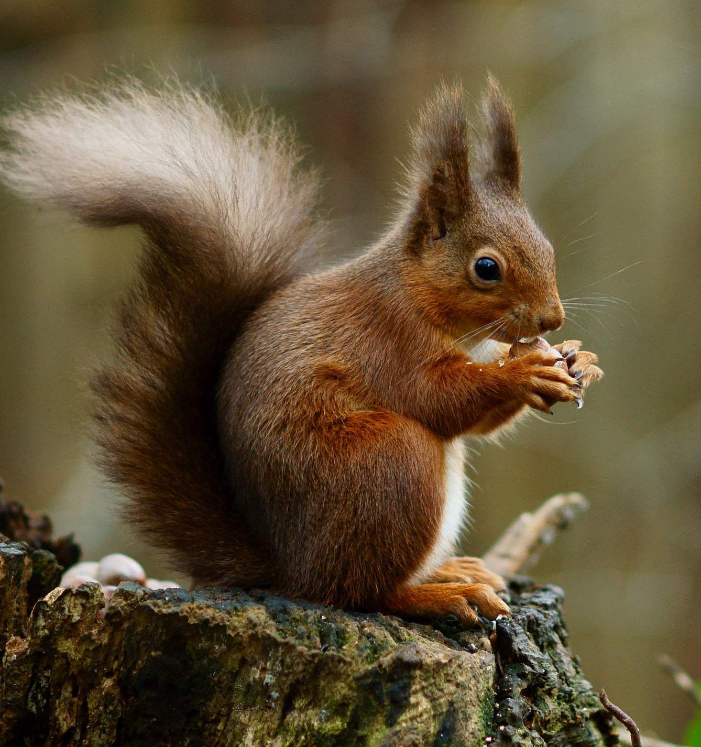
Results/Conclusions
- Our device performs well in controlled settings when confronted with stuffed animals
- Further testing is needed to see how it performs in the real world when confronted with real animals and weather conditions
- Transfer learning was an effective method of augmenting our data and improving prediction performance

